Slide 1
MULTI-LAYER ENCRYPTION AND DECRYPTION: A SECURE APPROACH USING SUBSTITUTION, RAIL FENCE, CAESAR CIPHERS AND PADDING

Slide 2
INTRODUCTION
Why Encryption Matters:
Rising security threats in digital communication.
Limitations of traditional single-layer encryption methods.
Proposed Solution:
A multi-layer encryption framework combining:
Substitution Cipher
Rail Fence Cipher
Caesar Cipher
Padding
Key substitution

Slide 3
ABSTARCT
WITH THE RAPID EVOLUTION OF DIGITAL COMMUNICATION, SAFEGUARDING SENSITIVE INFORMATION HAS BECOME PARAMOUNT. TRA DITIONAL SINGLE-LAYER ENCRYPTION METHODS, WHILE EFFICIENT, OFTEN FALL SHORT IN RESISTING SOPHISTICATED ATTACKS. THIS PAPER PROPOSES A MULTI-LAYER ENCRYPTION SCHEME INCORPORATING SUBSTITUTION, RAIL FENCE, AND CAESAR CIPHER TECHNIQUES. THE ENCRYPTION PROCESS LEVERAGES THE STRENGTHS OF THESE METHODS IN SEQUENCE TO ENSURE ROBUST SECURITY. DECRYPTION IS PERFORMED IN REVERSE, MAINTAINING DATA INTEGRITY WHILE PROVIDING A SEAMLESS RECOVERY OF THE ORIGINAL PLAINTEXT. THE PROPOSED SYSTEM IS ANALYZED FOR ITS COMPUTA TIONAL EFFICIENCY AND RESILIENCE AGAINST COMMON CRYPTANALYSIS TECHNIQUES.

Slide 4
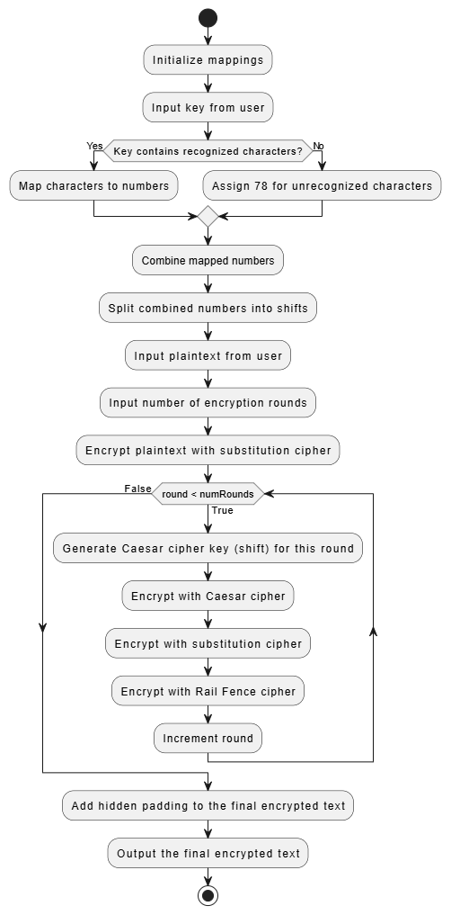
ENCRYPTIION ARCHITECTURAL DIAGRAM

Slide 5
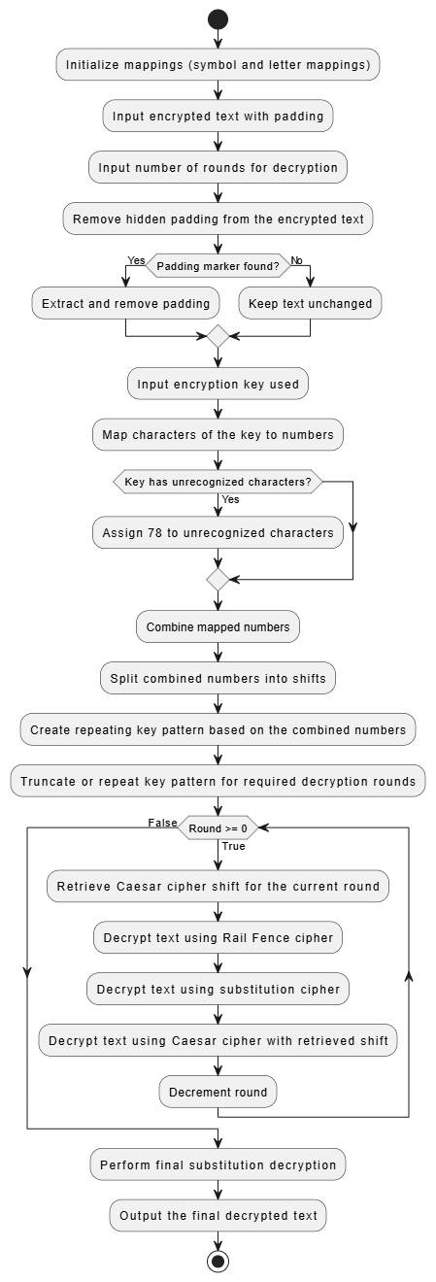
DECRYPTION ARCHITECTURAL DIAGRAM

Slide 6
ENCRYPTION PROCESS OVERVIEW
Substitution Cipher:
Replaces characters based on a dynamic mapping derived from the key.
Caesar Cipher:
Shifts the output of substitution cipher using a numeric key.
Iterative Process (Rounds):
Repeats encryption layers to add complexity.
Rail Fence Cipher:
Obfuscates text by rearranging it into a zigzag pattern.
Final Step:
Adds hidden padding for uniformity.

Slide 7
KEY FEATURES
Dynamic Key Mapping:
Each session generates unique mappings and keys.
Sequential Cipher Application:
Substitution first, followed by Caesar and Rail Fence.
Iterative Rounds:
Increases encryption strength with repeated layers.
Padding Mechanism:
Adds an additional layer of obfuscation.

Slide 8
ADVANTAGES
Enhanced Security:
Multi-layer approach resists frequency analysis and brute-force attacks.
Lightweight Algorithm:
Suitable for low-resource applications.
Dynamic Key Management:
Uniqueness in every encryption session ensures unpredictability.
Data Integrity:
Ensures accurate decryption without loss.

Slide 9
CONCLUSION
Multi-layer encryption offers robust security by leveraging lightweight ciphers.
Combines simplicity and strength for safeguarding sensitive information.
Provides resilience against common cryptographic attacks.

Slide 10
THANK YOU

